Slide 1


Company Profile
360°Repair & Maintenance Solutions at ONE-STOP
Diffusion Engineers Ltd..

Slide 2
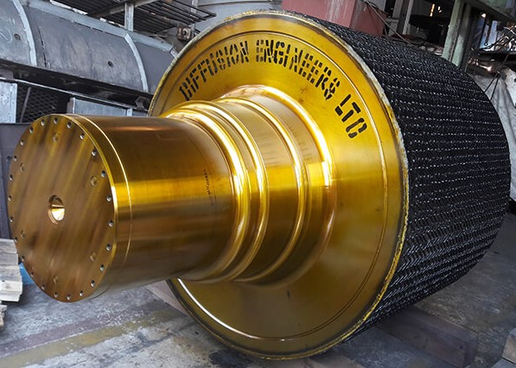
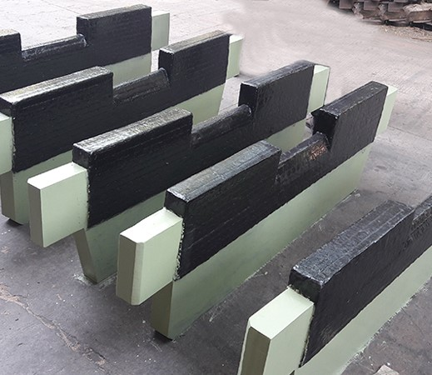
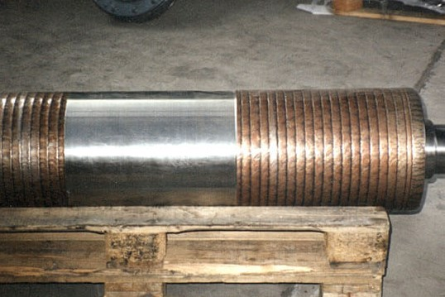
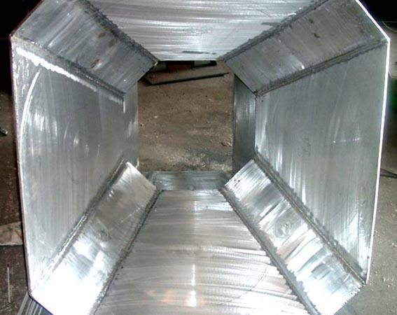
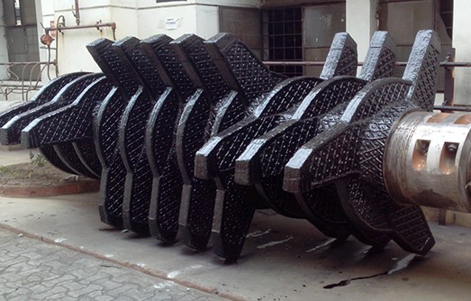
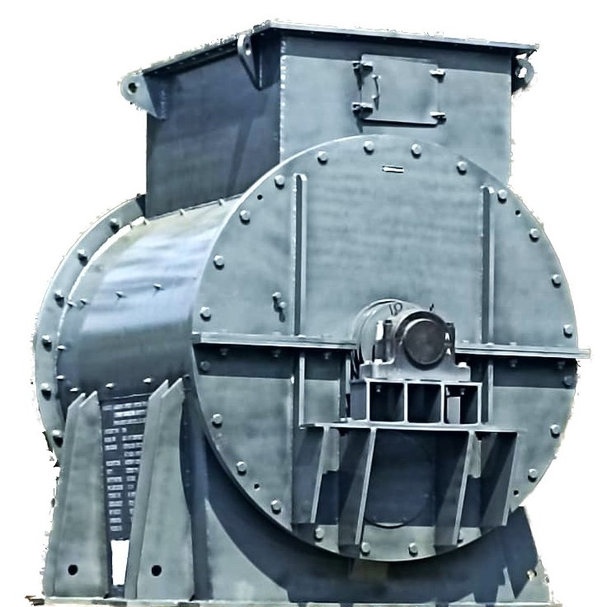
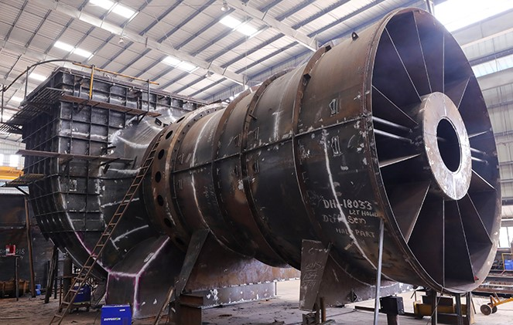
Four Decades
of
Superconditioning
DIFFUSION ENGINEERS LIMITED
Hingna Industrial Area, Nagpur (M.S.)
“Your one-stop destination for your Repair & Maintenance Solutions…. ”
Diffusion Engineers Ltd..

Slide 3



The Company
To Climb the rugs of success is an arduous task and continuous effort towards bettering performance.
The success story of Diffusion Engineers limited has its humble beginning in Nagpur in the year 1982 & serving the Cement, Steel, Power, Sugar, Mining, Railways, Defence Industry since last four decades.
Diffusion Engineers attained the status of a public limited company in 1995. Diffusion Engineers Limited, an IMS certified Company, pioneered the concept of Super-Conditioning in India. The new-generation Super conditioning materials and techniques offered by the Company enormously enhance the life of worn-out equipment and components. Diffusion offers a wide range of Lo Temp and Anti-wear alloys to suit the reclamation needs of industry.
Today Diffusion Engineers Ltd. Has grown to a one among the best metallurgical and engineering solution provider in maintenance & repair welding field. Following the basic tenets of management and evolving corporate culture, today Diffusion stands tall as the pioneer of the New Age Industrial Solutions.
A team of competent engineers located at Chennai, Faridabad, Jamshedpur, Nagpur, Pune, Secunderabad and Vadodara formed the backbone of Diffusion products and reclamation services. Further, the company has established a nationwide network of distributors and dealers to address every customer’s need. Dealers & services are also available in South-East Asian countries, the Middle East and Africa.
Founder – Late Shri N. K. Garg
He was one of the founders of Diffusion and Under his stewardship, the Company has grown to INR 2 billion by 2022.
His Growth Mantras are customer focus, focus on high quality service & professionalism, building trust & relationships, and continuous learning process.
He has introduced many new technologies in the Indian industry and has vast experience in solving wear problems.
M.D. – Mr. Prashant Garg
MBA from Saïd Business School, University of Oxford with focus in Strategy, M & A and Leadership.
He earlier completed his B.E. in Industrial Engineering and was among the top rankers at Nagpur University.
He developed a state-of-the-art production facility to manufacture sophisticated cement, power and steel plant equipment at Diffusion and also pioneered the concept of total wear solutions.

Slide 4
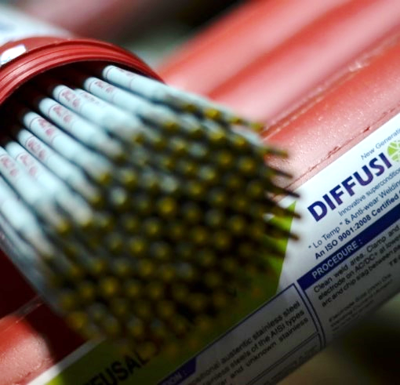
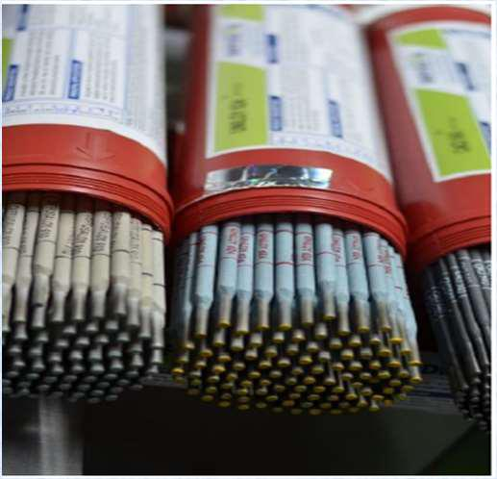
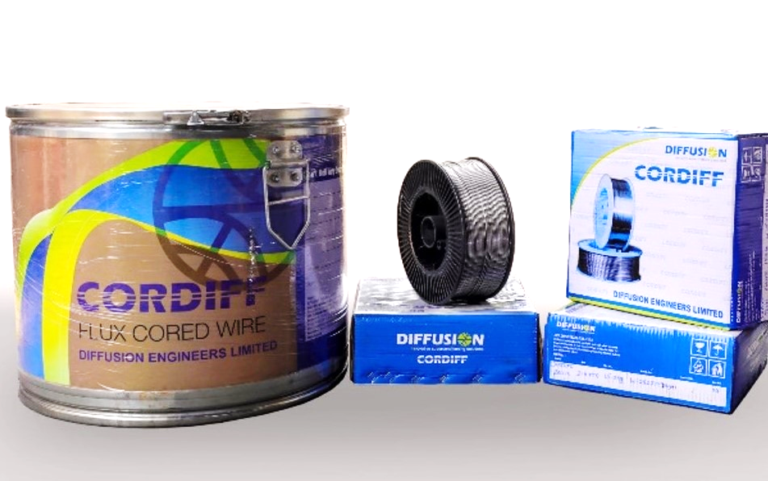
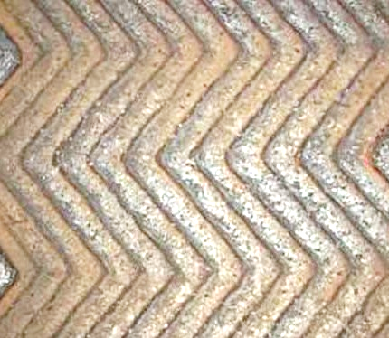
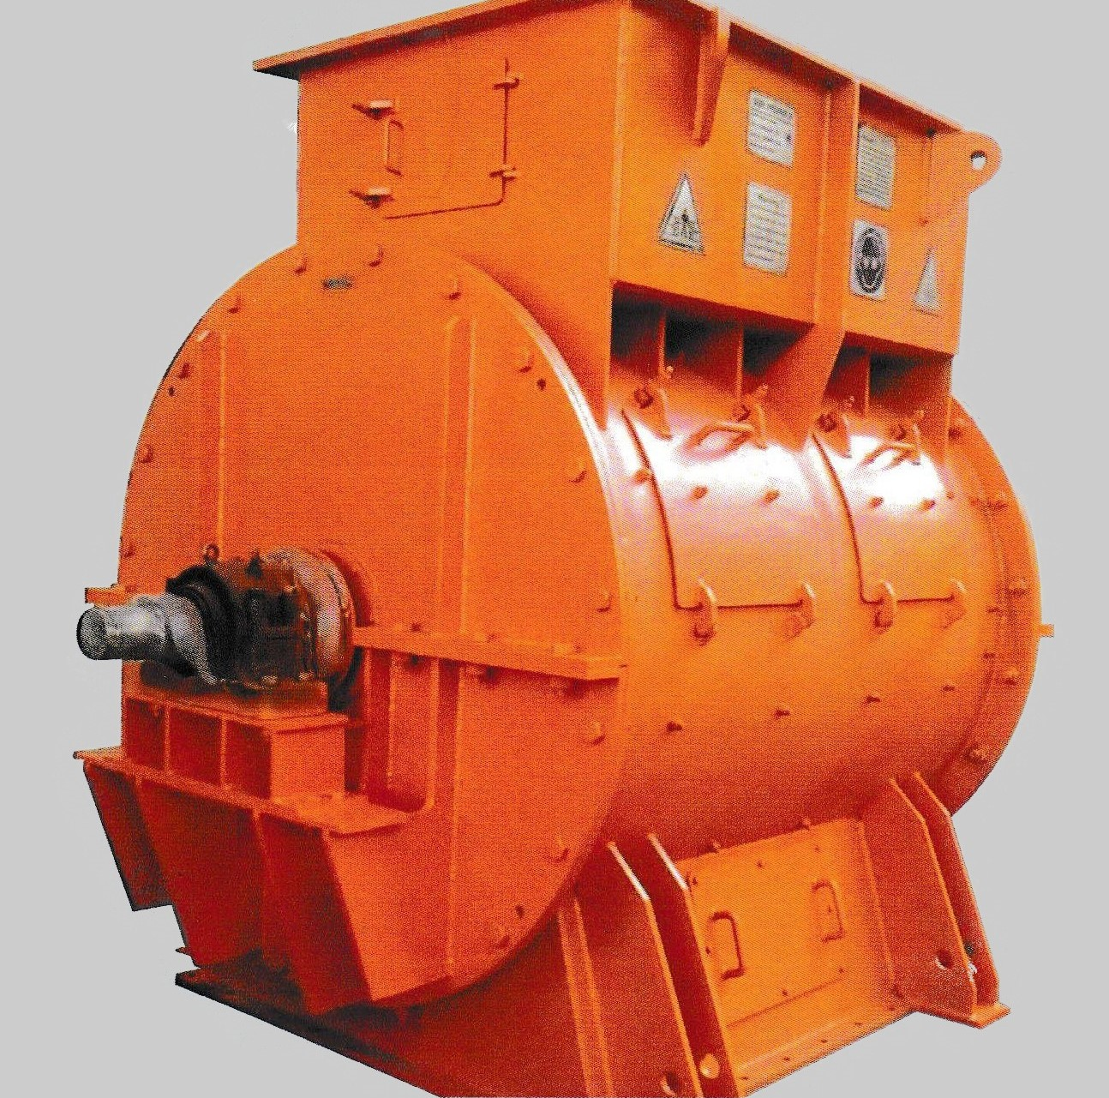
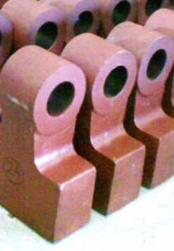
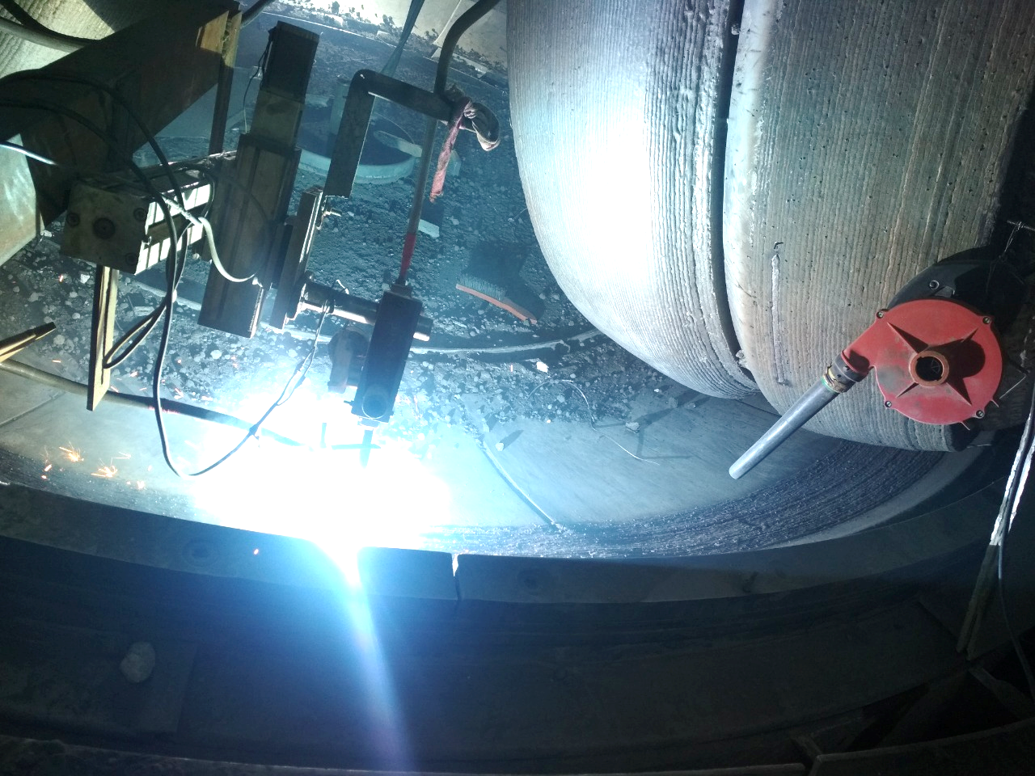
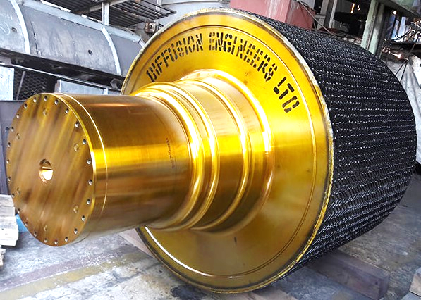
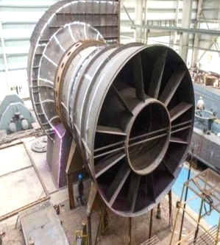
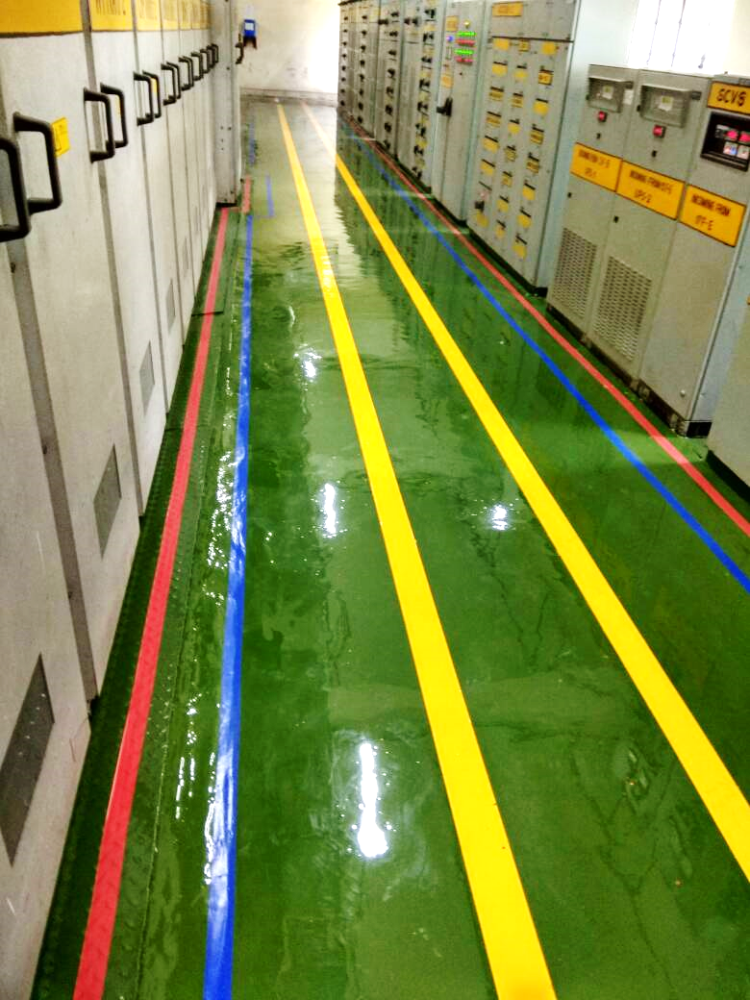
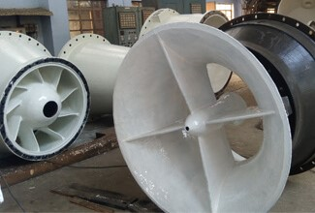
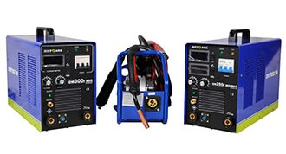
Product & Services
Lo Temp Joining & Antiwear Welding Electrodes
Flux Cored Wires, TIG, MIG Filler Wires
Composite Wear Plates
Pre-Hardfaced Fabricated jobs
Pre-Hardfaced Castings
In Situ Superconditioning
Service Welding of VRM Rolls, Concast Rolls
Heavy Engineering
Coatings & Repairing Compounds
Welding & Cutting equipments

Slide 5
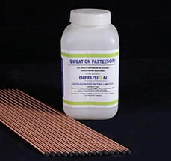
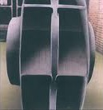
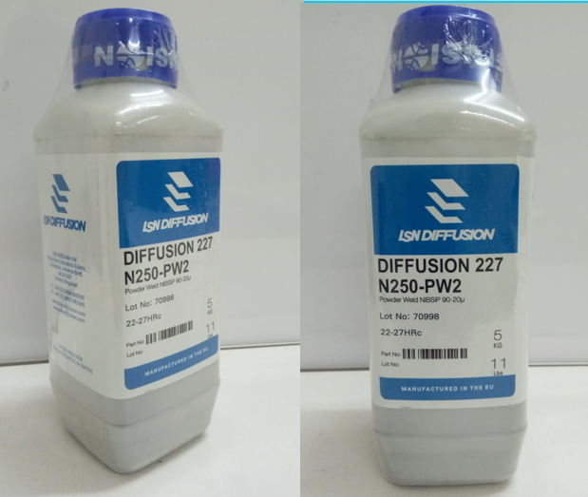
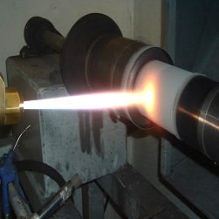
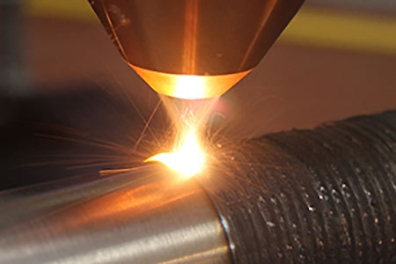
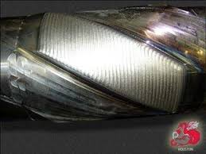
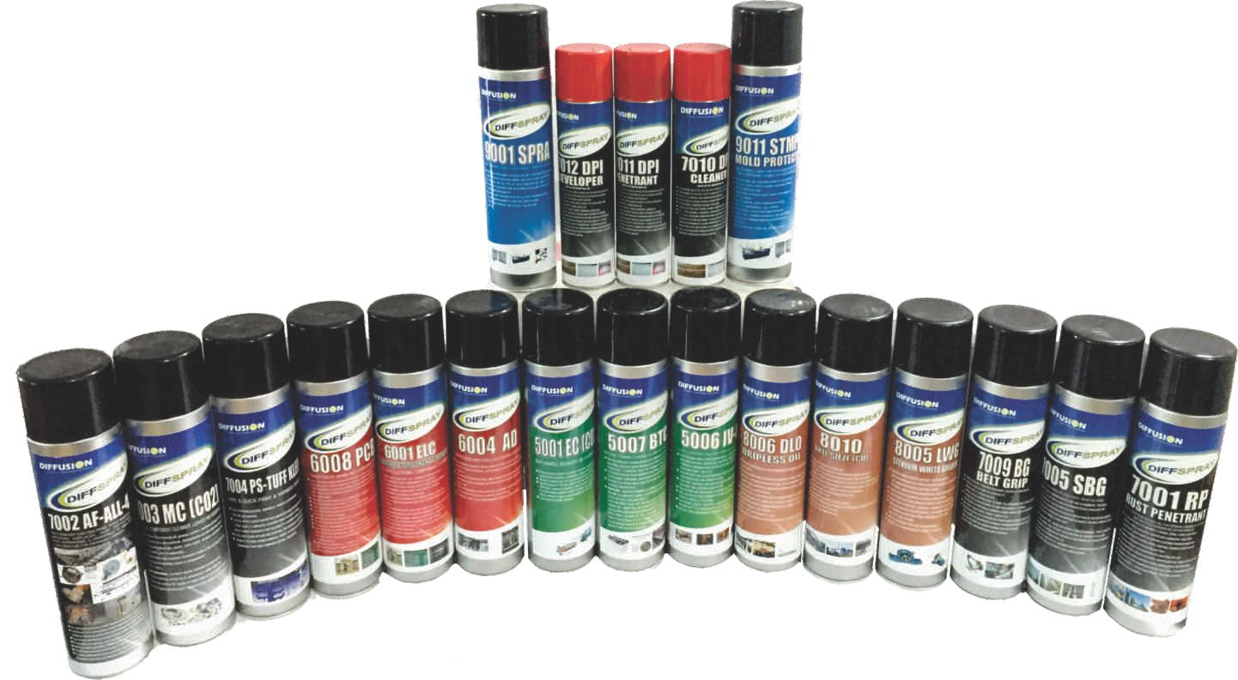
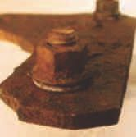
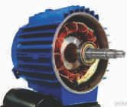
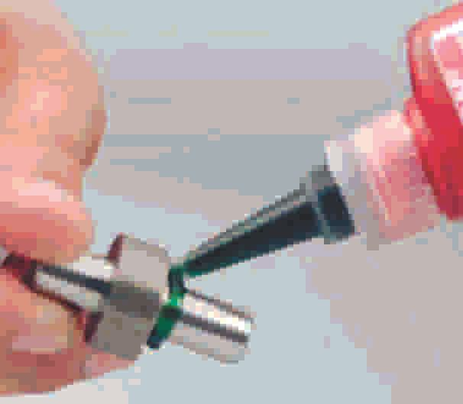
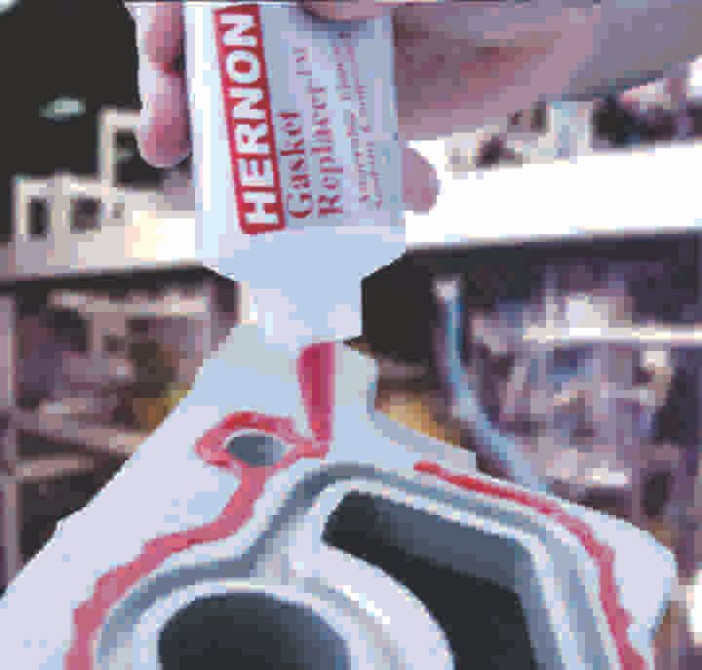
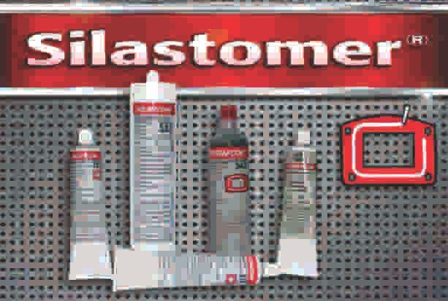
Product & Services
SOP – Sweat On Paste
(Ultra High Hardness of 68-72 HRC)
Nickel & Cobalt based Powders & Services
Nickel & Cobalt Surfacing Alloys & Services
DIFFSPRAY – Aerosol Maintenance Spray (Mechanical & Electrical)
DIFFUSION – HERNON Adhesives & Sealants

Slide 6
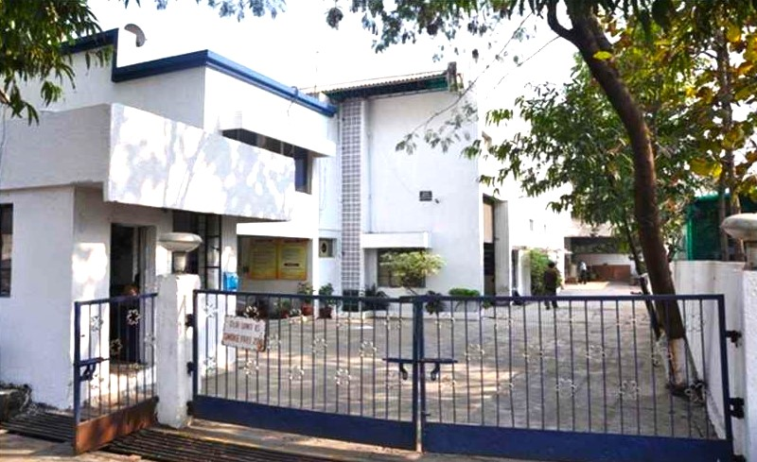
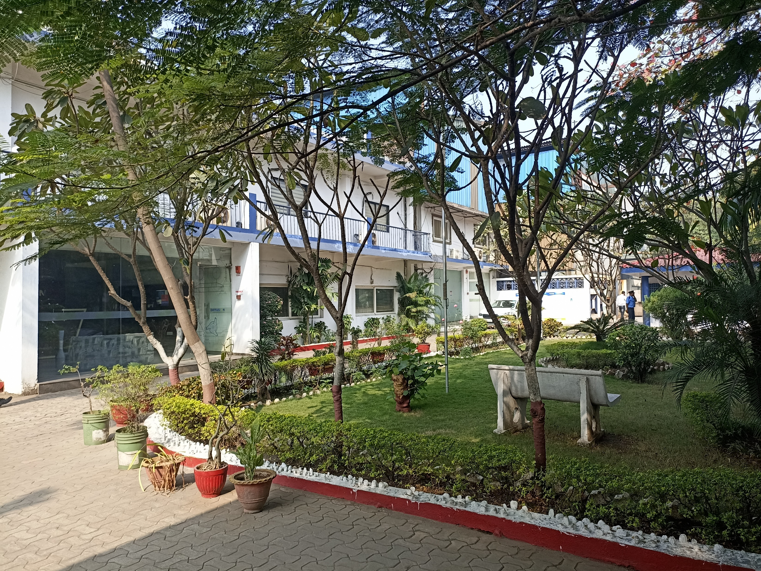
Our Works/ Facilities & Services
UNIT I :
T 5&6, Hingna Industrial Area,
Hingna, Nagpur-440016
ANTIWEAR DIVISION
Welding Alloys Manufacturing
Quality and R&D
Admin, HR & Finance
UNIT II:
N 78 & 79, Hingna Industrial Area,
Hingna, Nagpur-440016
SUPERCONDITIONING DIVISION
Wear Plate Manufacturing
Flux Cored Wires
Reconditioning & Superconditioning Jobs
Pre-Hardfaced Fabricated Components
Diffusion Knowledge Centre

Slide 7
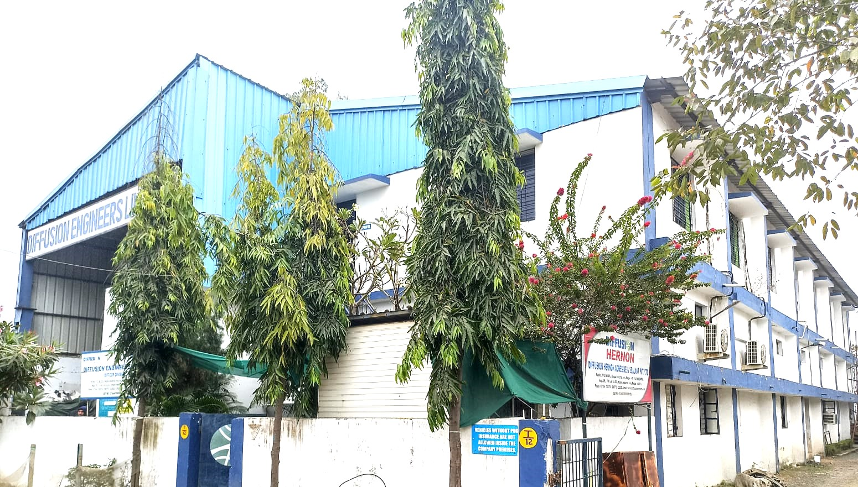
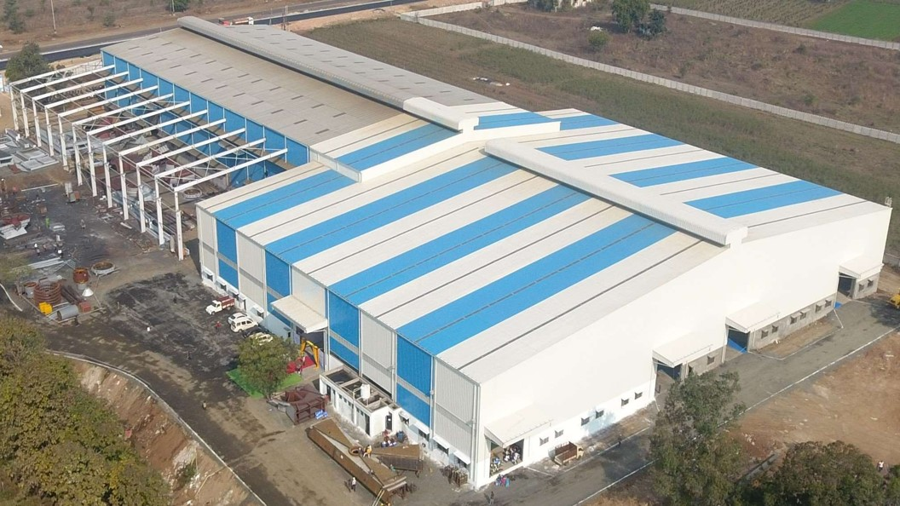
Our Works/ Facilities & Services
UNIT III:
T 12, Hingna Industrial Area,
Hingna, Nagpur-440016
DIFCOR DIVISION
Cold Repair Maintenance & Repair Compounds
Chemical Resistance/ Floor & Insulation Coatings
DIFFSPRAY – Aerosol Maintenance Spray
DIFFUSION HERNON Adhesives & Sealants
Welding & Cutting equipments
UNIT IV:
Khasra no. 35, Khapri Uma Gondkhairi Road, Kalmeshwar, Nagpur
HEAVY ENGINEERING DIVISION
A state of art facility with shed area of 1,80,000 sq. ft.
It is a Heavy engineering division where Cement, Steel, Power Plant equipment are manufactured.
Wear Plate Manufacturing

Slide 8
Joining & Hardfacing Welding Electrodes
Diffusion is primarily a manufacturing company which provides increased durability products. It achieves this due to its metallurgical know-how, understanding of application domain and experience in design of new solutions.
Diffusion is having:
Capability of developing new alloys
Understanding of application domain, wear areas in different industries
Very wide range of hard facing and special joining electrodes
The range includes:
Anti-wear Alloys
Complex Carbide Alloys
Work Hardening Alloys
Flame Hardening Alloys
Super Anti-wear Alloys
Cobalt Based Composite Alloys
Tungsten Based Composite Alloys
Complex Carbide Alloys
Joining Alloys
High Tensile Alloys
Stainless Steel Alloys
Manganese Steel Alloys
General Purpose Alloys

Slide 9
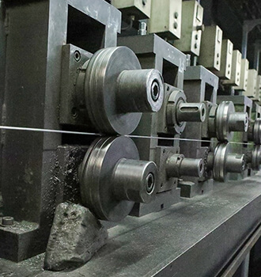
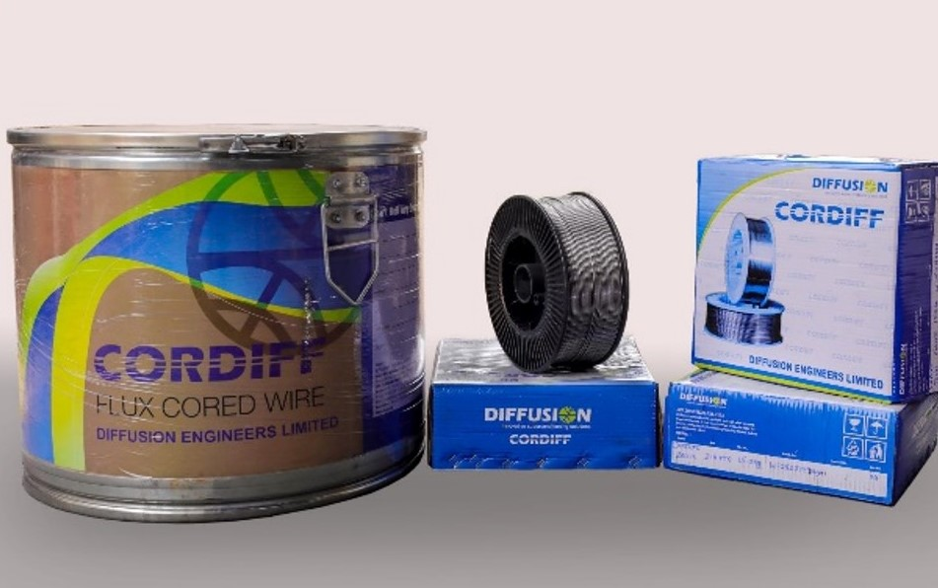
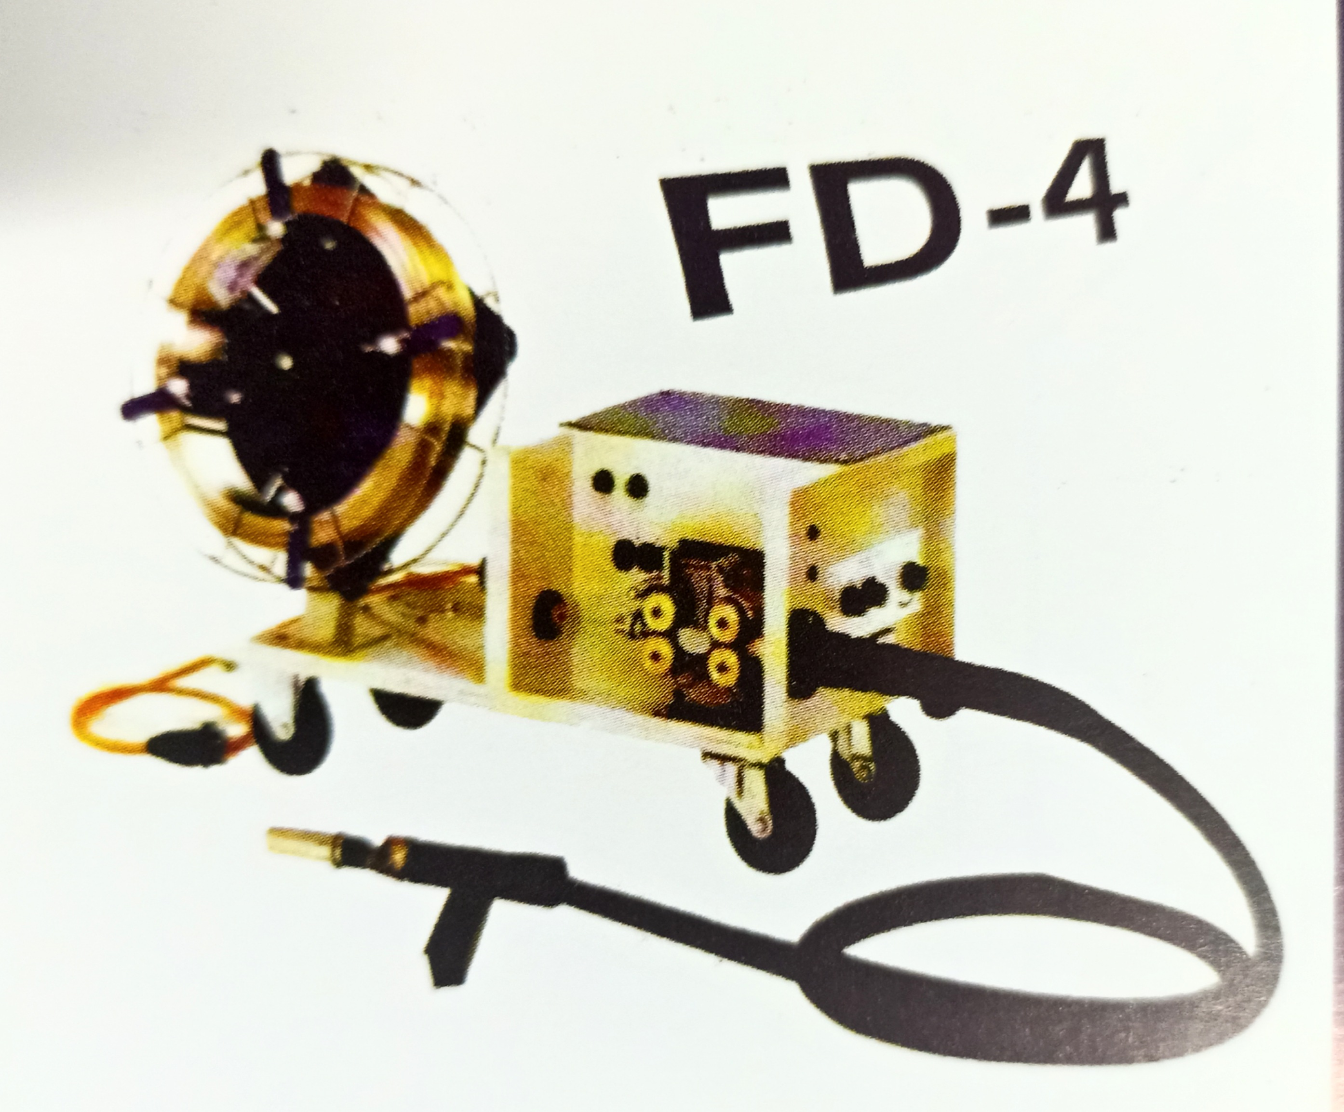
Flux Cored Wires
The advance welding technology of self-shielded flux-cored continuous arc welding was introduced by DIFFUSION in technical collaboration with CORODUR Gmbh (Germany) to the core sector industries. As a part of our commitment towards continuous development of products, technology and services, for higher productivity and reduction in input cost.
In 2015 ‘CORODUR’ has become ‘CORDIFF’
CORDIFF self shielded flux cored welding wires consist of an outer metallic sheath of steel or a special alloy with ferro-alloys i.e. metallic particles and mineral particles which are balanced to produce a specific alloy in the core.

Slide 10
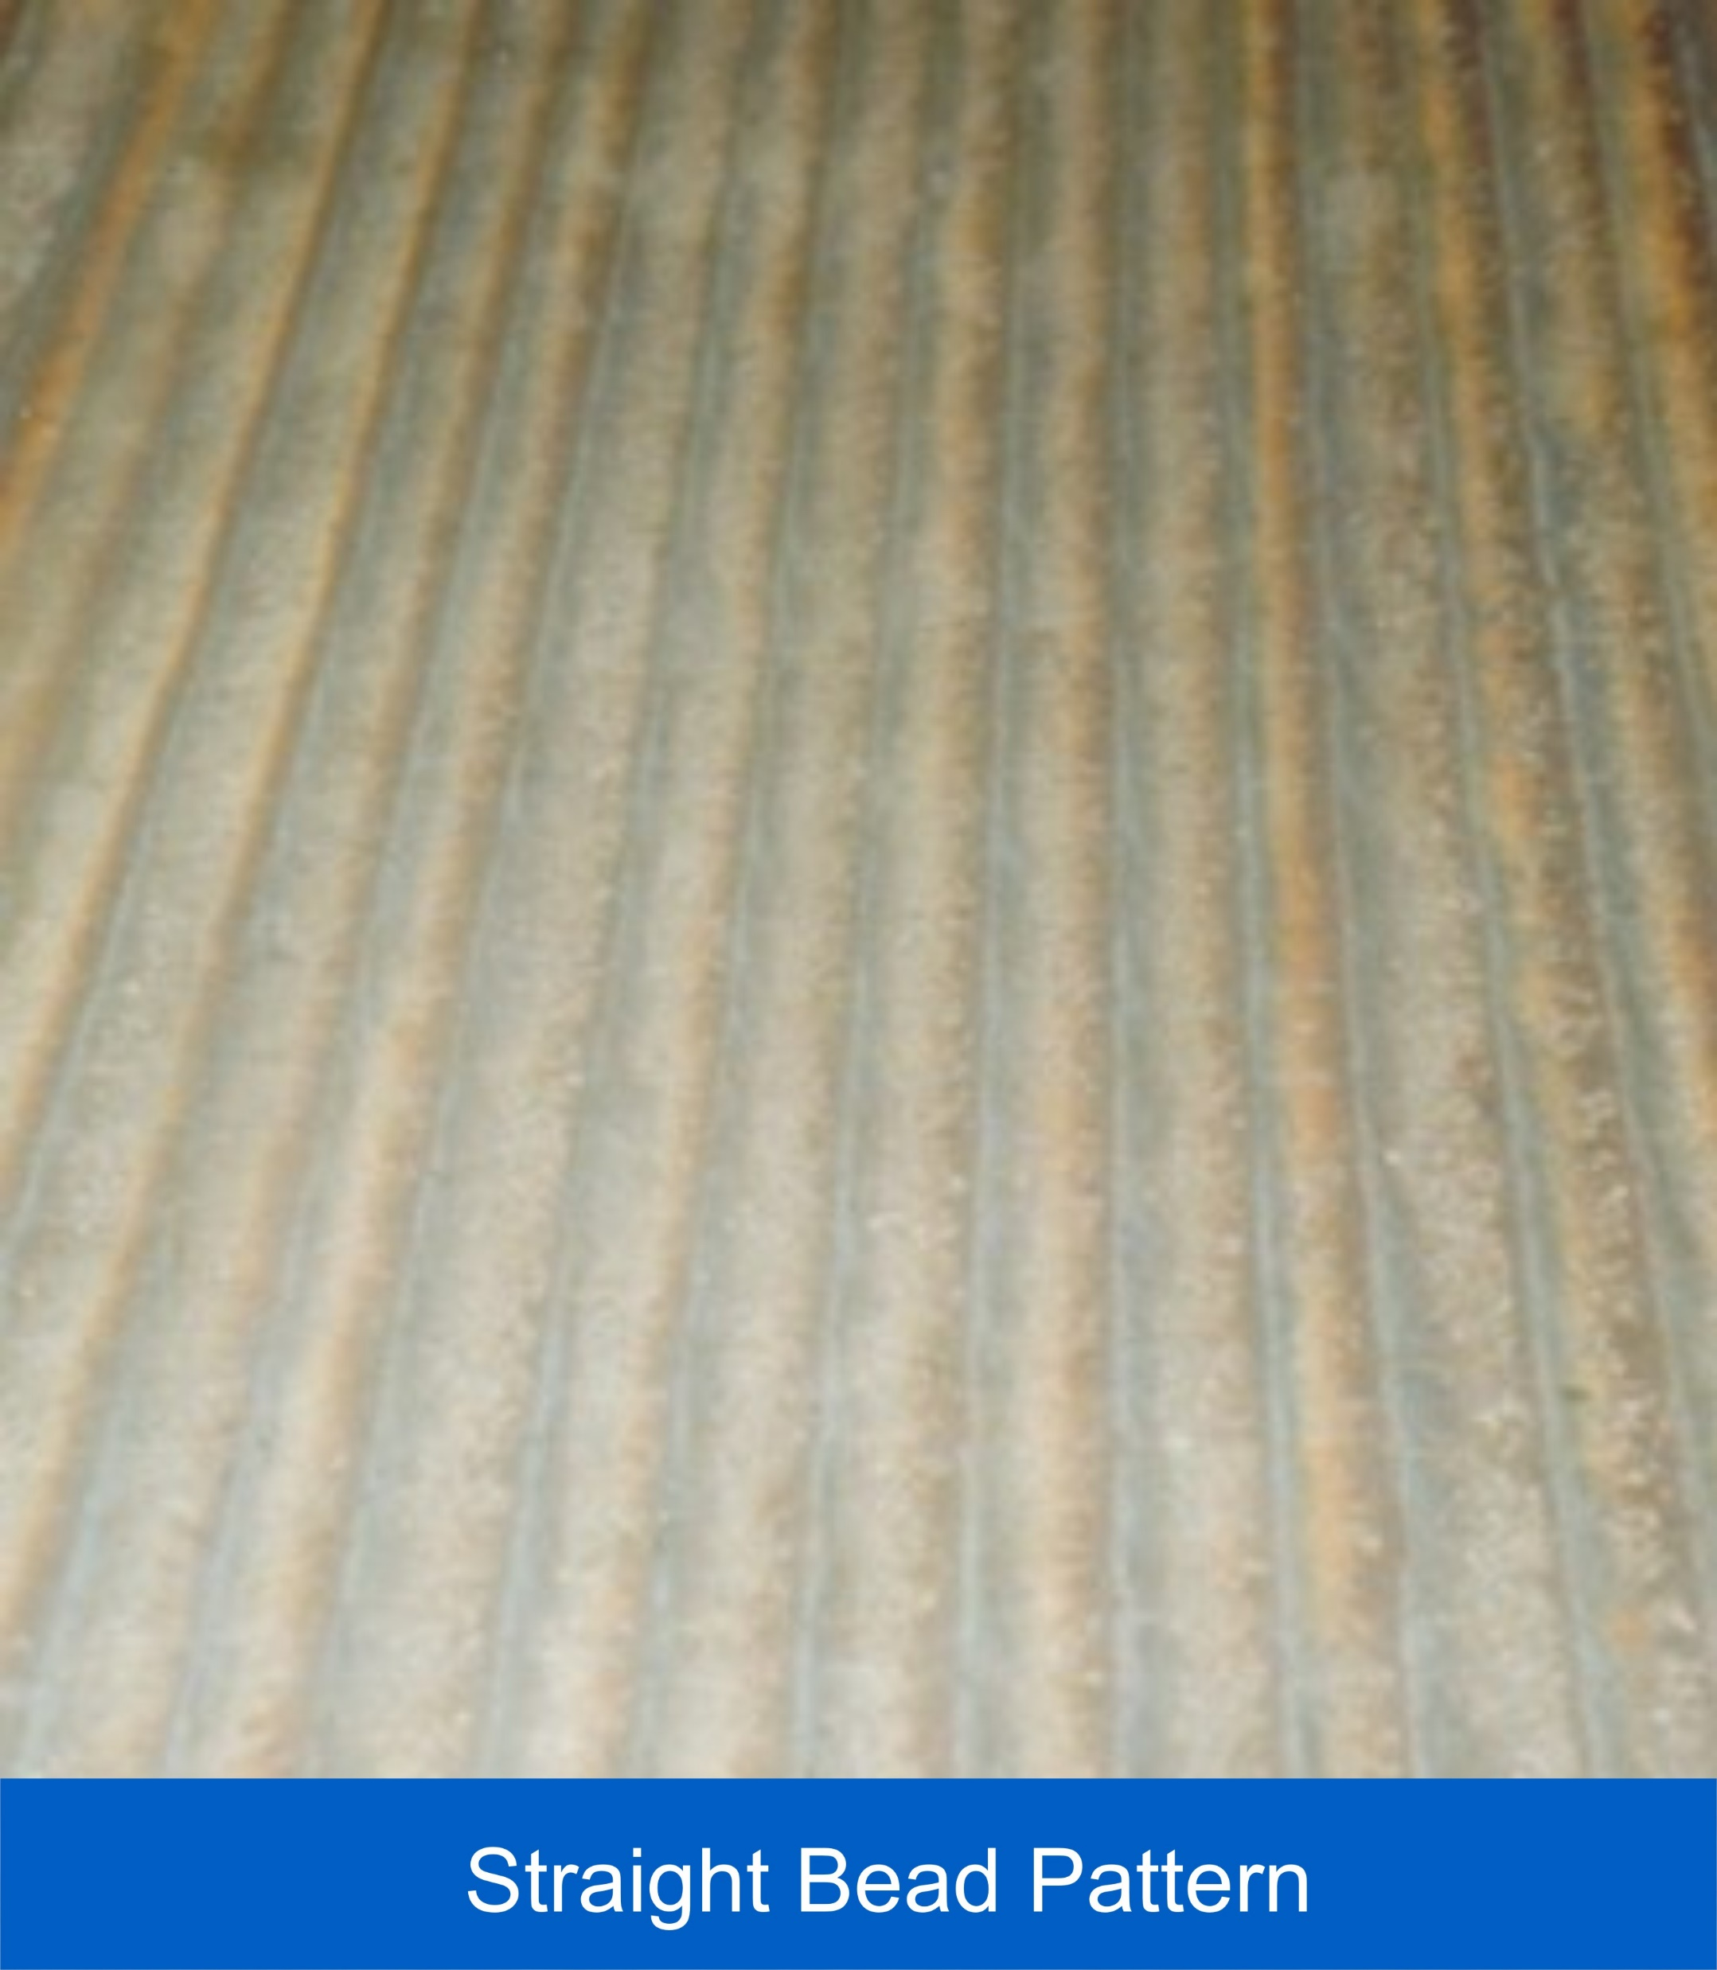
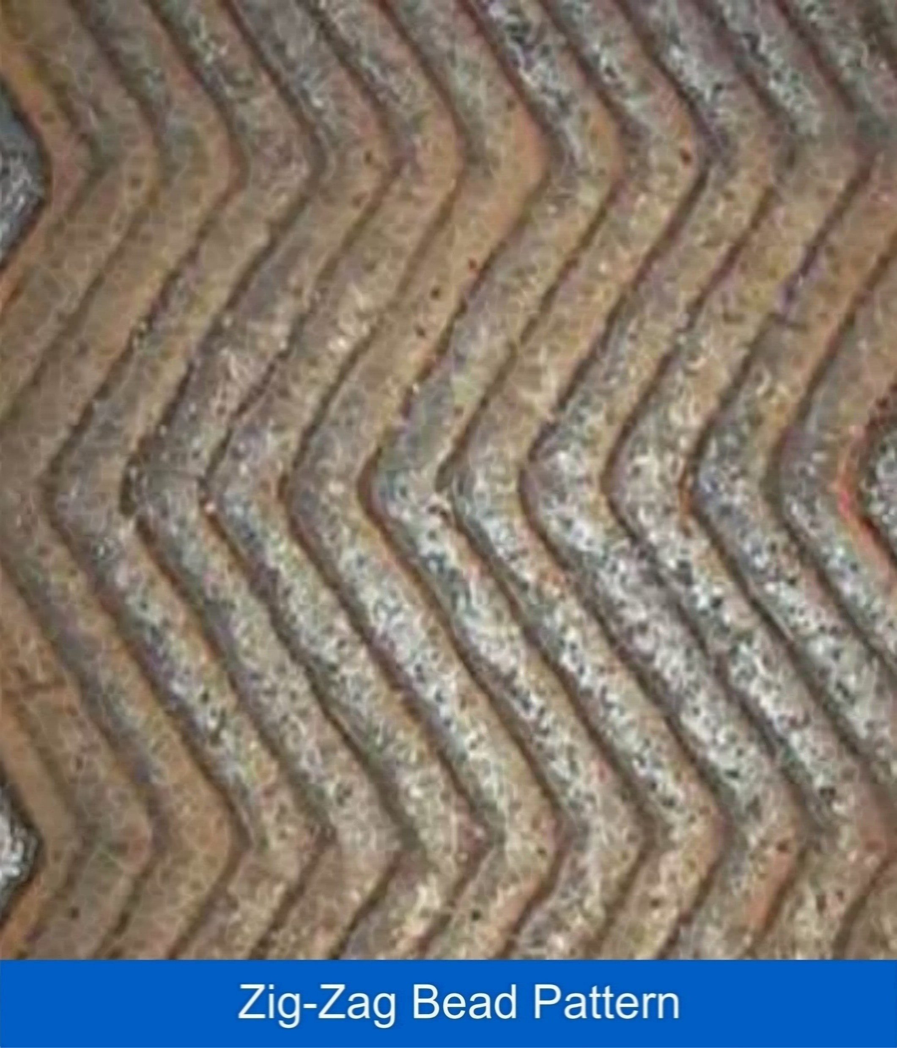
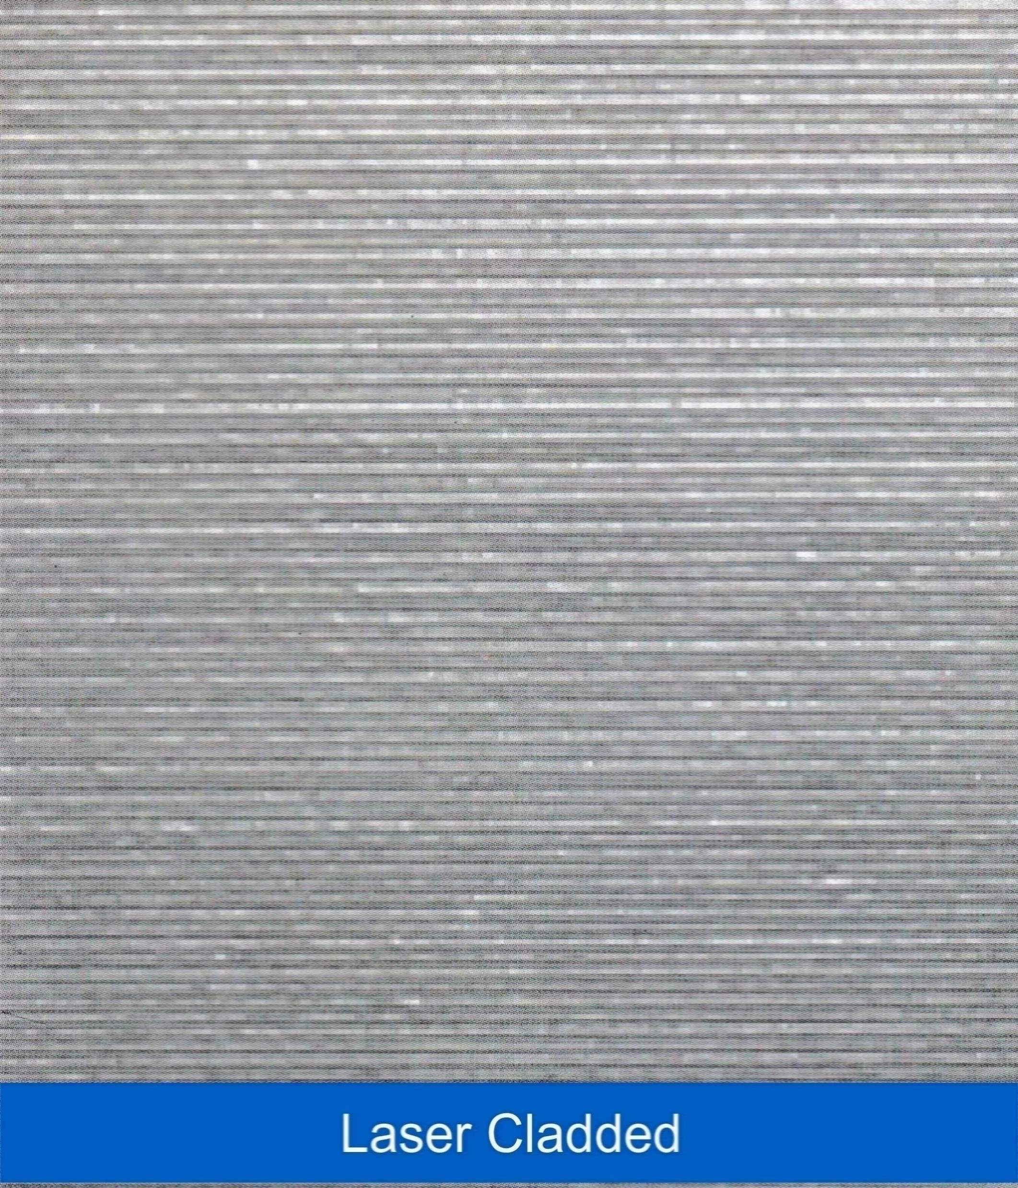
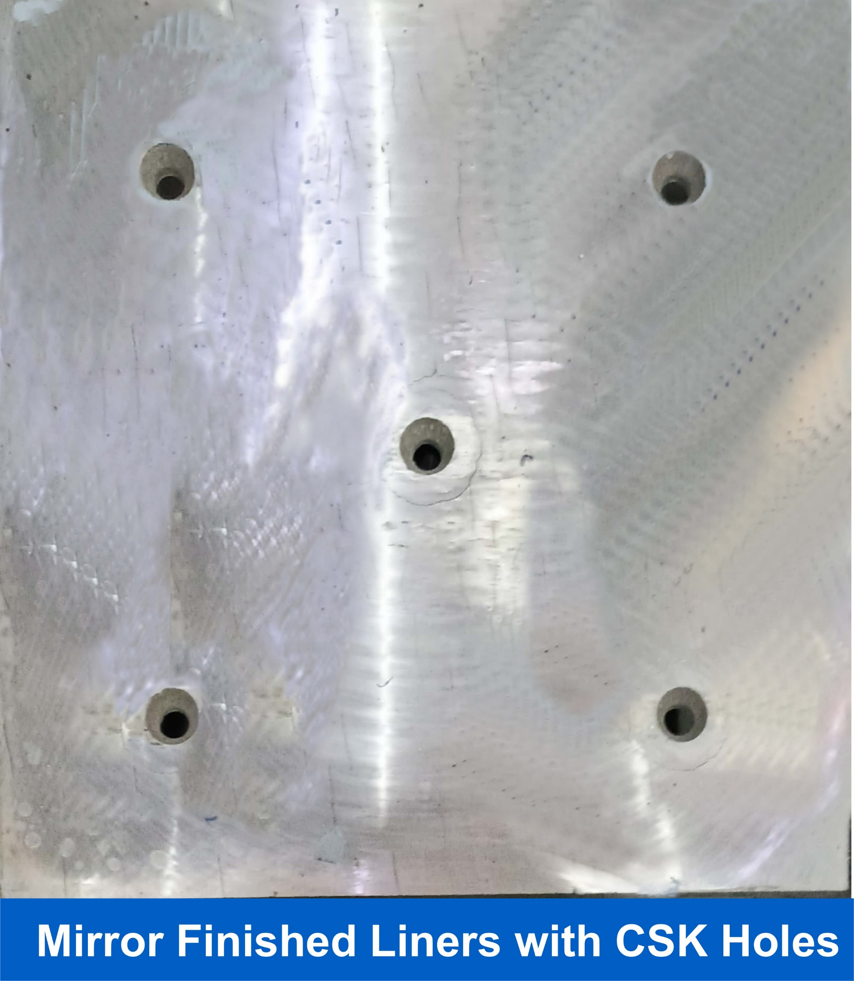
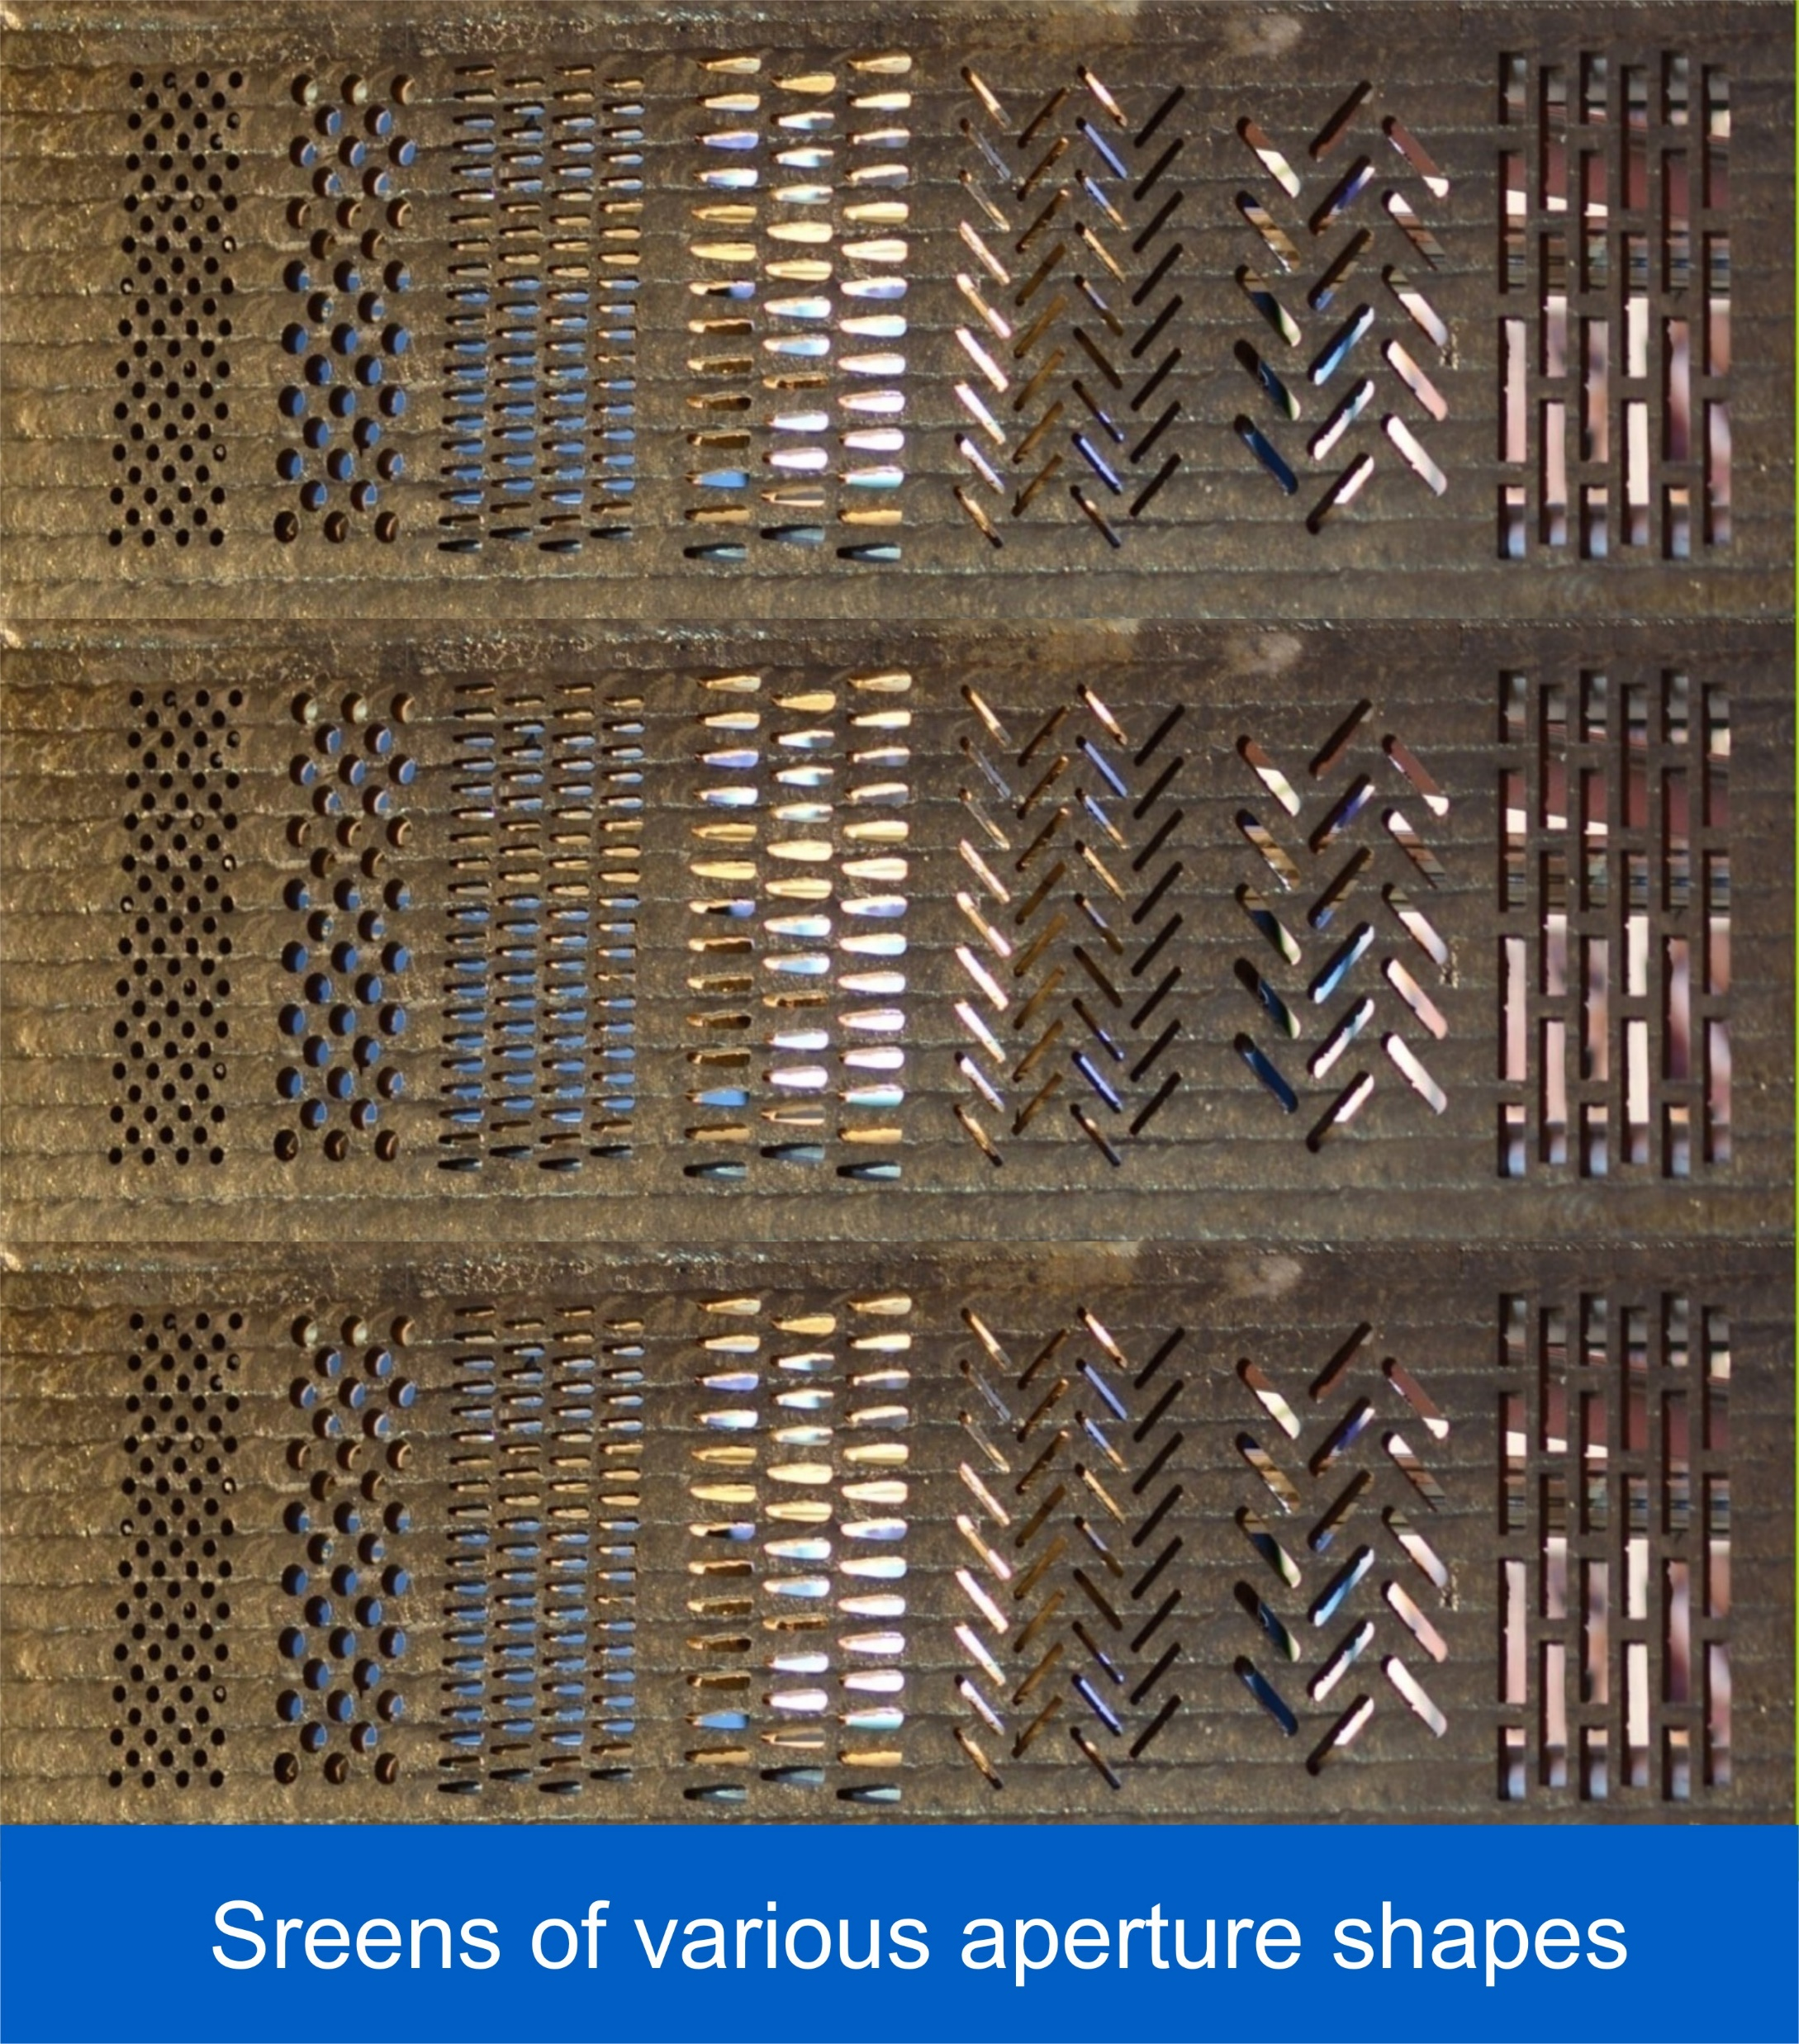
Composite Wear Plates
DIFFUSION manufactures a wide range of composite wear plates (Steel Plates with hard wear resistant overlays) using Flux Cored Wire welding process. The required Flux Cored Wires are manufactured by DIFFUSION itself at its high technology production unit.
DIFFUSION has mastered the art of overlaying with Flux Cored Wires welding under the guidance of highly experienced German Technicians & Engineers from Corodur.
The morphology of the overlay, the bead profile and the fine pattern of stress relief cracks ensures that during service, the deposit would not spall even under extreme conditions.
DIFFUSION R&D is fully capable of developing custom made overlay composition to meet specific application needs of customers.

Slide 11
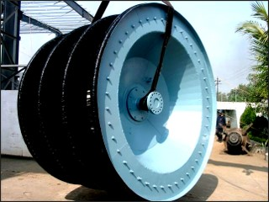
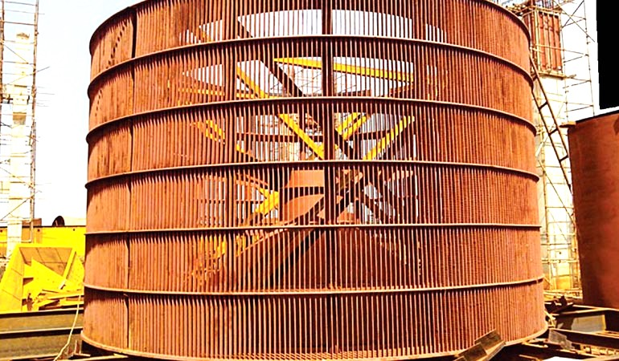
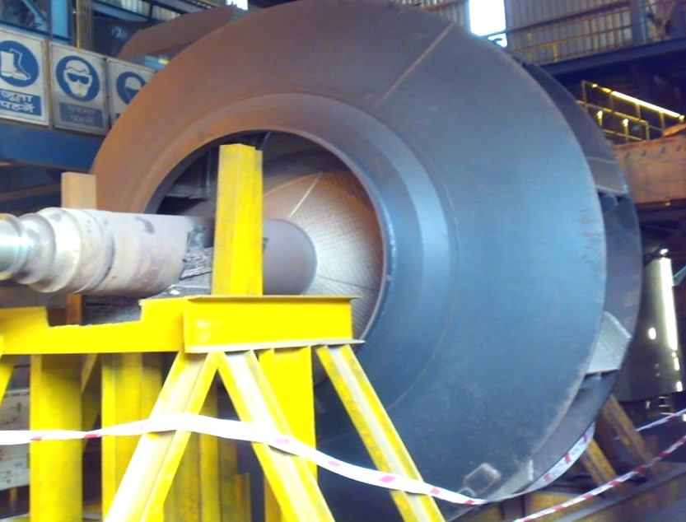
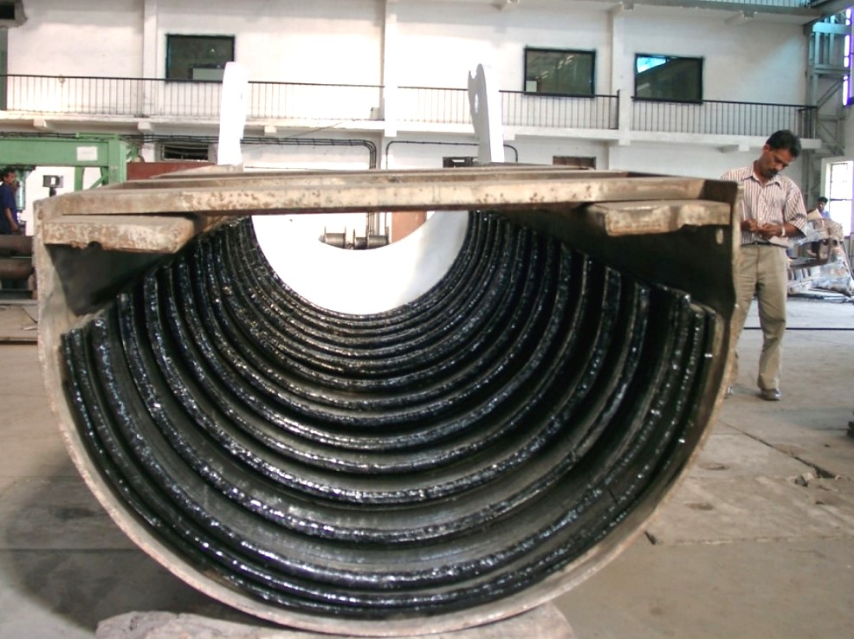
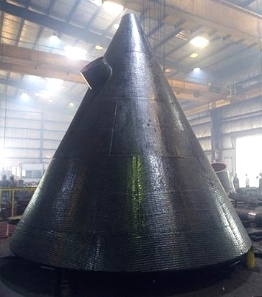
Pre-Hardfaced Fabricated Jobs
DIFFUSION Has all the required facilities required for fabrication viz. : Plasma Cutting, Welding, Bending, Hole Making etc. as such the wear plates can be offered either simply as liners, or can be fabricated into complete system and sub-systems of Cement, Steel Sugar, Power & Material Handling plants, as per customers design.
Some salient fabricated components using pre-hardfaced Wear Plates are:
Rotary Air Lock
Cage Wheel
Separator Rotor
Fan Impellars
BLT Chute Liners
Grit Cone

Slide 12
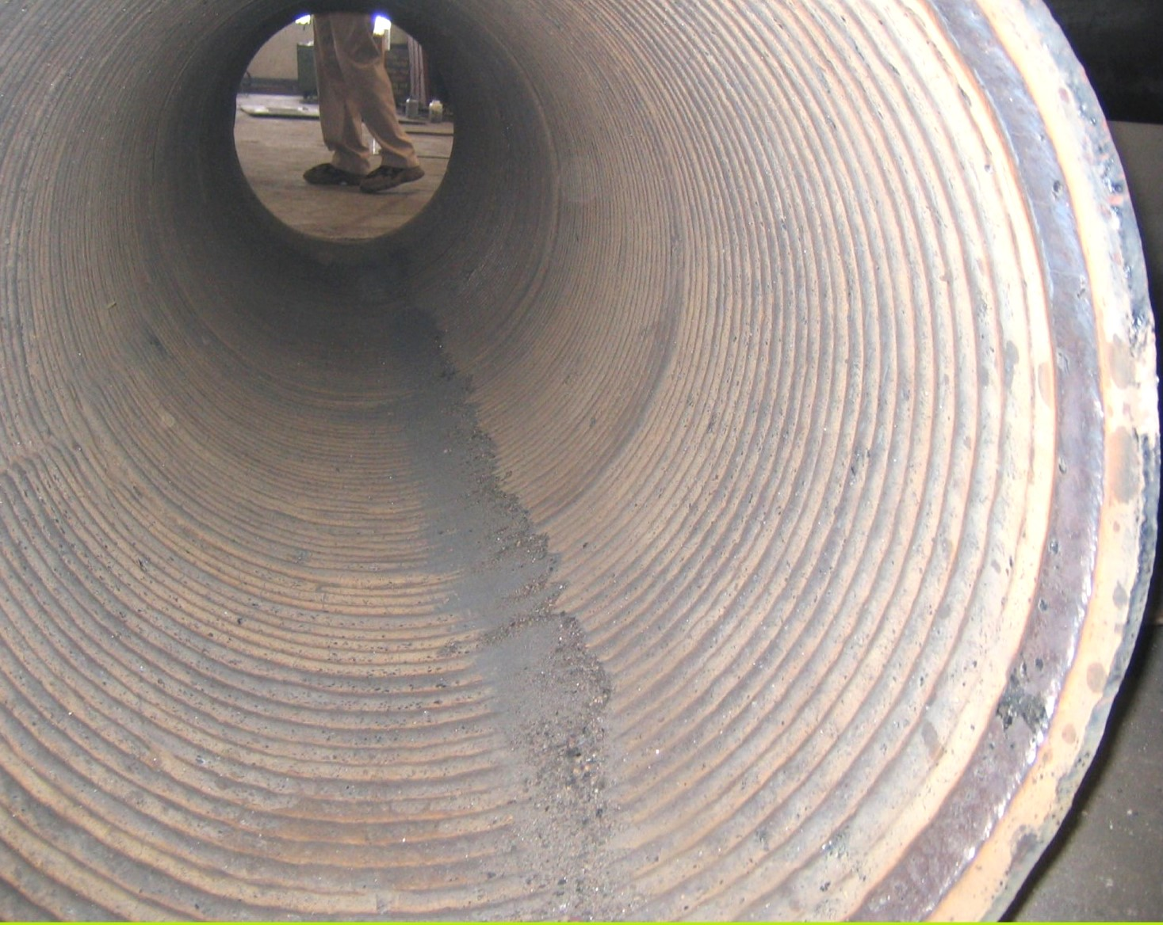
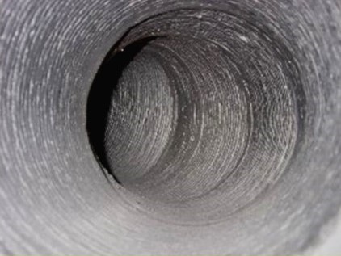




Pre-Hardfaced Fabricated Jobs
Some salient fabricated components using pre-hardfaced Wear Plates are:
Internally Harfaced Pipes
Internally Hardfaced Bends
FK Pump Screw
Octopus Feed Chute
Mirror Finished Hopper
Mirror Finish Static Collars

Slide 13





Pre-Hardfaced Fabricated Jobs
Some salient fabricated components using pre-hardfaced Wear Plates are:
Buckets
Big Size Screw Conveyors
Grizzly Bars
Internally Hardfaced Ducts
New RPR
CCS Rolls

Slide 14





Service Welding
DIFFUSION specializes in three approaches of Reconditioning – Offline, In-situ & Breakdown.
Some salient components reconditioned using these approaches are:
RAL Superconditioning
Big Bell
Roller Press Roll
Sinter Spikes
Roller Hub
Grinding Rolls

Slide 15





Service Welding
Some salient components reconditioned :
Crusher Rotor
VRM Tyre
Fan Refurbishment
CCS Rolls Cladding
In-situ VRM Tyre Reconditioning
In-situ RPR Reconditioning

Slide 16






Service Welding
Some salient components reconditioned :
Loco Wheel
Bucket Reconditioning
Crusher Hammers
RAL Reconditioning
Rollers Laser Cladding
BLT Chutes Reconditioning

Slide 17

Heavy Engineering
Our ‘Heavy Engineering Division’ is located at Nimji near Kalmeshwar, spared over 1,80,000 sq.ft.
At this plant all sort of heavy jobs are executed including manufacturing of Cement, Steel, Power Plant equipments.
Some salient equipment manufactured :
PA Fan Statics Casing
Cooler ESP Duct

Slide 18


Heavy Engineering
Some salient equipment manufactured :
FLS ROKSH Separator Rotor
Mill Body

Slide 19


Heavy Engineering
Some salient equipment manufactured :
APH Rotor
KILN Shell

Slide 20






Coating & Repairing Compounds
Some salient coating & repairing compounds jobs :
Impeller Coating DIFFGUARD
Impeller Coating DIFFGLASS 1000
Pipe Coating DIFFGUARD XTREAM
Bearing area repairing UNI METAL
Pump Casing CERAMETAL
Classifier Blades CERABEAD XTREAM

Slide 21






Coating & Repairing Compounds
Some salient coating & repairing compounds jobs :
Hopper Ceramic Lining
Acid Storage area
bund lining DIFFGUARD
Floor Coating
DIFF FLOOR
Floor Coating
DIFF FLOOR
Insulation Coating
DIFF INSULATE
Insulation Coating
DIFF INSULATE

Slide 22






Coating & Repairing Compounds
Some salient coating & repairing compounds jobs :
Bag House Coating
DIFFGLASS XTREAM
Bag House Coating
DIFFGLASS XTREAM
Machinery protection DIFFGLASS PRIME
Pipe Internal Coating DIFFGLASS 1000
Pipeline & Structural Coating DIFF TOP
Heavy Duty Shop Floor Coating DIFFLEX

Slide 23




Welding & Cutting equipments
Some salient products:
Wire Feeder Machine
FD-4
Thermal Spray Powders
DURALOY TORCH
MMA/ ARC Welding Inverters
MIG Welding Inverters
AIR PLASMA Cutting
MIG/ MAG/ MMA
Welding Inverters

Slide 24

The Complete range of Mechanical & Electrical Maintenance Aerosols

Slide 25




High Performance Adhesives & Sealants
High Performance Adhesives & sealants
Some salient applications:

Slide 26





























Our Key Domestic Customers

Slide 27











Our Major OEM Clients

Slide 28
















Our Major Overseas Clients

Slide 29

Our Nationwide Network

Slide 30

Our Worldwide Network

Slide 31

A feather in our cap…… our organization is…

Slide 32

THANK YOU…
..your partners in the war against WEAR

